Slide 1
Object Oriented Programming Using Java -Day 5
Intermediate Level

Slide 2
Recap of Day 4
Inheritance
Method Overriding
‘final’ and ‘ super’ Keywords
Abstract classes and methods

Slide 3

Session Plan – Day 5
Interfaces
Packages
Object Oriented Analysis and Design

Slide 4
Why Interface ?
  The requirement is to define the prototype of all the methods of the class , leaving the definition/implementation to the user of the class. How do we implement this?
  This is done with the help of an interface
  Interfaces are very useful when an unrelated set of classes have a common set of methods.
Notes:
Interface are syntactically like class. But it will not have instance variables and all the method are abstract.

Slide 5
Define an interface
Interface can be defined as follows
All the methods are public and abstract by default
All the variables are public static final variables by default
<<Access specifier>> <<interface>><<interface name>>{
//methods
}
Why methods should be public and abstract?
Notes:
Implementation of the methods are done in some other class .

Slide 6
Implementing an interface
Interface can be used with the help of ‘implements’ keyword
Once the interface has been defined ,any number of classes can implement that interface
If the class implements the interface, the class must implement all the methods defined in an interface or declare itself abstract
<<class >><<class name>> <<implements>><<interfacename1>>[, interfacename2,……]

Slide 7
Interface Example (1/4)
interface Customer{
void setCustomerName(String name);
String getCustomerName();
}
interface Employee{
void setEmployeeNo(int no);
int getEmployeeNo();
}
class Trainee implements Customer,Employee{
String bName,cName;
int empNo;
public void setBatchName(String name){
bName=name;
}
Define an Interface
Class Implementing two interfaces

Slide 8
Interface Example (2/4)
Implementing an Interface
class Trainee implements Customer,Employee{
String bName,cName;
int empNo;
public void setBatchName(String name){
bName=name;
}
public String getBatchName(){
return bName;
}

Slide 9
Interface Example (3/4)
public void setCustomerName(String name){
cName=name;
}
public String getCustomerName(){
return cName;
}
public void setEmployeeNo(int no){
empNo=no;
}
public int getEmployeeNo(){
return empNo;
}
}
All the methods are overridden in the implemented class with same signature

Slide 10
Interface Example (4/4)
class InterfaceExample{
public static void main(String args[]){
Trainee trobj=new Trainee();
trobj.setCustomerName("Alphy");
System.out.println("Customer Name:"+trobj.getCustomerName());
trobj.setEmployeeNo(1001);
System.out.println("Employee No:"+trobj.getEmployeeNo());
trobj.setBatchName("Mar09");
System.out.println("Batch Name:"+trobj.getBatchName());
}
}
Customer Name:Alphy
Employee No:1001
Batch Name:Mar09

Slide 11
Interface Example (4/4)
class InterfaceExample{
public static void main(String args[]){
Trainee trobj=new Trainee();
trobj.setCustomerName("Alphy");
System.out.println("Customer Name:"+trobj.getCustomerName());
trobj.setEmployeeNo(1001);
System.out.println("Employee No:"+trobj.getEmployeeNo());
trobj.setBatchName("Mar09");
System.out.println("Batch Name:"+trobj.getBatchName());
}
}
Customer Name:Alphy
Employee No:1001
Batch Name:Mar09

Slide 12
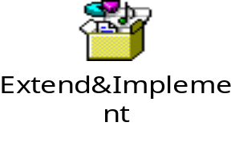
‘extends’ and ‘implements’ with class
A class can extend from another class and at the same time can implement any number of interfaces
<<class>> <<class name>>extends <<class name>><<implements>><<interface name1>>[, interface name2>>,……]{
//methods
}
Notes:
Implementing Interfaces
By including the implements clause in a class definition, we implement an interface.
public class classname2 [extends classname1] [implements interface…] {}
The methods redefined in the class implementing the interface must be declared public. Also, the type signature of the implementing method must match exactly the type signature specified in the definition of the interface.

Slide 13
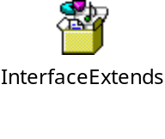
interface Inheritance
An Interface can extend from one another interface with the help of the keyword extends
<<interface>> <<interface name>> <<extends>><<interface name>>{
//methods
}

Slide 14
Abstract Classes vs Interfaces
Abstract Classes | Interfaces
Can have concrete methods | Can have only abstract methods
Can have variables | Can have only static final (constant) data members
Can have private and protected members | All members are public abstract by default
Can be extended from one class | Can be extended from any number of interfaces
A class can extend only one abstract class | A class can implement any number of interfaces

Slide 15
Can you Answer ?
Say true or false
  An abstract class can have a non abstract method
  If the class has one abstract method then that class should be declared abstract
  All the methods of an interface are abstract by default
  All the methods of an abstract class is abstract by default
  Interfaces can extend from any number of interfaces
  A local variable can be defined in an interface
  A class can implement any number of interfaces
  An object of an interface can be created

Slide 16
Packages
In the Retail Application, let us assume that the code has been written by programmers who are in different teams which are distributed. When the code is integrated, they expect name clashes to occur between the class names used . Further security of data is required between classes written by different programmers. We need to -
  Identify a means segregating the classes logically and implement access specfiers for security
We will learn–
Packages

Slide 17
Packages

Slide 18
Packages
Packages are Java’s way of grouping a number of related classes and interfaces together into a single unit
Different type of Packages
  Built in package
  User defined package

Slide 19
Java Program Structure
package
classes
class/instance variables
methods
local variables
statements
…….

Slide 20
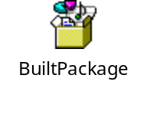
Accessing Classes from the Packages
There are two ways to access a class associated with package
Method 1:
  Using fully qualified class name
    java.lang.lang.Math.sqrt(varOne);
Method 2:
  Import package and use class name directly
    import java.lang.Math
    Math.sqrt(varOne);
Notes:
A package is a collection of related classes. Packages are containers for classes that are used to keep the class name space compartmentalized.
The package declaration, if any, must be at the beginning of the source file. You may precede it with white space and comments, but nothing else. Only one package declaration is permitted and it governs the entire source file.
A java program can contain any of the following four parts.
A single package statement (optional)
Any number of import statements (optional)
Any number of classes and interfaces out of which only one class can be public
The package statement defines a namespace in which classes are stored. It is nothing but a directory, in which a class is defined. When the package name is omitted, it is put into the default package, which has no name (i.e.. The current directory)

Slide 21
User Defined Packages
Package can be created with the help of ‘package’ keyword
Package should be the first statement in the source file(.java)
package <<package name>>;
public class classname{
//Code goes here
}
class classname{
}
Notes:
Organize your classes into smaller units and make it easy to locate and use the appropriate class file – i.e., you can split up the classes logically.
Avoid naming conflicts – Hierarchical approach to store files/classes.
Packages allow you to protect your classes, data and methods in a larger way than on a class-to-class basis.
Package names can be used to identify your classes.

Slide 22
User Defined Packages
Sub package can be created as follows:
package <<first package name>>.<<second package name>>;
public class classname{
//Code goes here
}
class classname{
}

Slide 23
Adding a Class to a Package
A package can be spread across different .java files
In one .java file, there could be only one class declared public and that becomes the name of the .java file
A package can however have several public classes spread across multiple .java files.
  More than one class/interface can have the same name but it should be in a different package
Accessing user defined package can be done by using any of the following methods:
  Using fully qualified class name
  Import package and use class name directly

Slide 24
Accessing a User Defined Package (1/3)
Using fully qualified class name
Package statement
package addition;
public class AddTwo{
private int sum;
public void calSum(int varOne,int varTwo){
sum=varOne+varTwo;
System.out.println("Sum= "+sum);
}
}

Slide 25
Accessing a User Defined Package (2/3)
Package statement
package calculation;
class PackEx{
public static void main(String args[]){
addition.AddTwo obj=new addition.AddTwo();
obj.calSum(23,46);
}
}
fully qualified class name
Sum=69

Slide 26
Accessing a User Defined Package (3/3)
    Import package and use class name directly
Package statement (first statement)
package addition;
import addition.AddTwo;
class PackEx{
public static void main(String args[]){
AddTwo obj=new AddTwo();
obj.calSum(23,46);
}
}
import statement
Sum=69

Slide 27
Access Modifiers - Revisited
Java has 4 access control modifiers
  private: Accessible only within the class
  default: No keyword, Accessible only within the package
  protected: Similar to default with the addition that available to all child classes; that is, even if child class is in a different package
  public: Accessible to all
Data Members and Methods can have any of these specifiers
Classes and Interfaces can have either the public access or the default access

Slide 28
Access Control
Accessible to | public | protected | default | private
Same class | Yes | Yes | Yes | Yes
All classes in the same package | Yes | Yes | Yes | No
All sub classes in the different package | Yes | Yes | No | No
All classes in the different package | Yes | No | No | No

Slide 29
Built in package(1/3)
These packages provides the set classes , interface and method for the programmer to develop an application in an easier way
Programmer can reuse everything from the package and save effort
Few examples of built in packages
  java.lang
  java.io
  java.sql
  java.awt
  java.net

Slide 30
Built in package(2/3)
java.lang
  Contains classes that are essential for developing basic Java programs
  The String class, System class etc, belong to this package
  There is no need to explicitly import this package
java.io
  Helps to perform various input and output operations
Java.sql
  Provides classes and interface that helps to connect to the database like SQL server, oracle easily

Slide 31
Built in package(3/3)
java.awt
  Classes for implementing GUI Application eg: windows, buttons, menus etc.
java.net
  Classes for networking

Slide 32
Uses of Packages
Logical grouping of classes and interfaces
Avoiding name clashes
Provides an extra level of protection to its members
How to avoid name clashes?
How can extra level of security be provided
Notes:
Answer:With the help of packages , we can avoid the name clashes. But in one package class names cannot be repeated.
While using C language , the values of global variables can be changed by any code/programmer in the same project. But in Java this can be prevented by default access specifier. Only the class in the same package can access the data member or the member function

Slide 33
Object Oriented Analysis and Design &UML

Slide 34
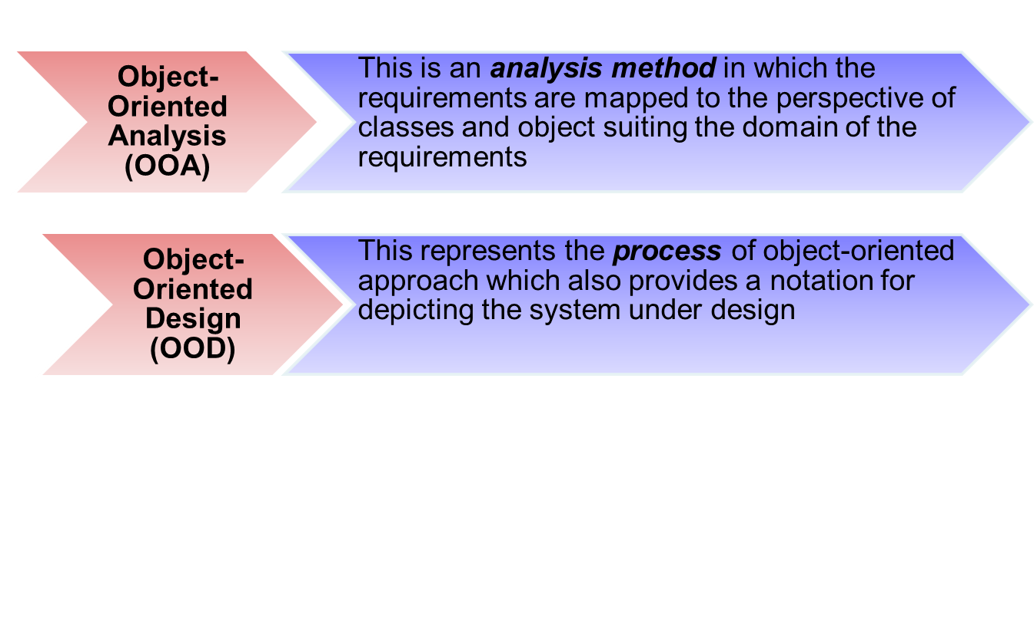
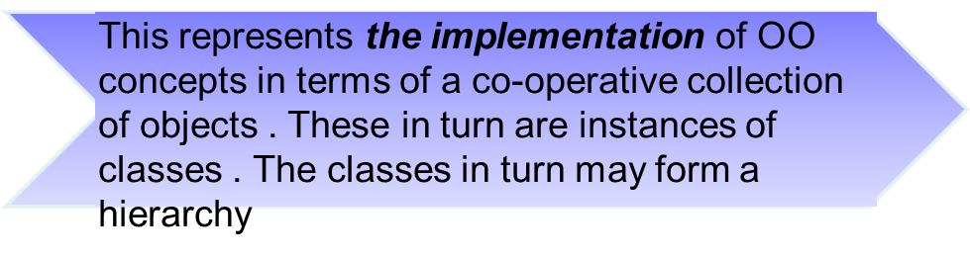
Terminology…
Object-Oriented Programming (OOP)
Notes:
The definitions may map to the following:
OOA - The process of identifying the required classes (objects) and their relationships
OOD - The process of identifying the data members and methods of the classes identified
OOP - The process of implementing the design using an OO programming language

Slide 35
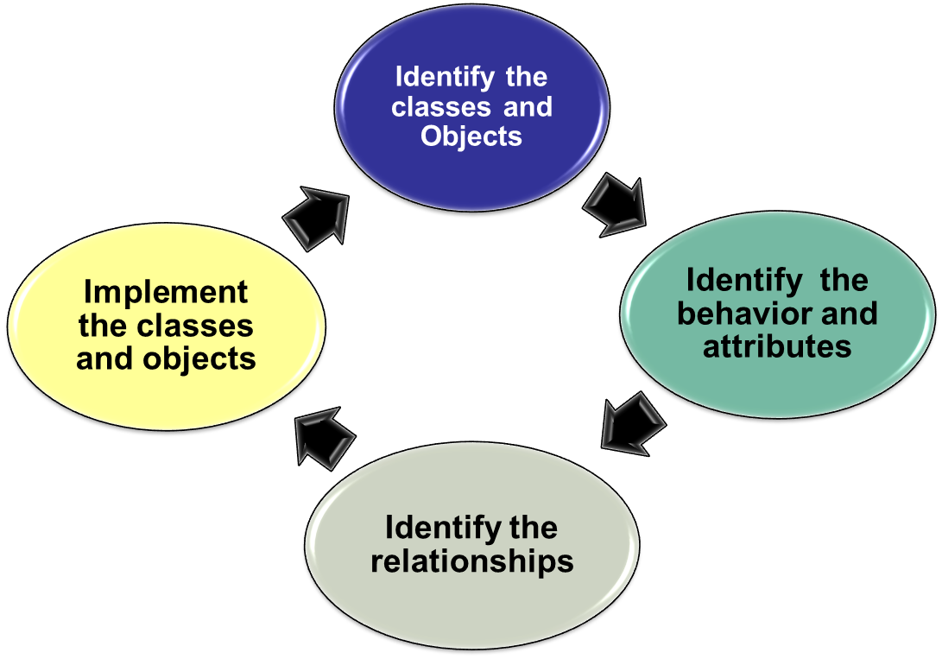
Object Oriented Process(Developer’s Perspective )
This figure shows the object oriented development process which is followed by developers

Slide 36
What is a Model?
A model is an abstract representation of a system constructed from a perspective to understand the system prior to building or modifying it.
A static (or structural) model can be seen as a “picture" of a system's parameters at a specific point in time.
A dynamic (or behavioural) model is a collection of procedures or behaviours that, taken together, reflect the behaviour of a system over time
Notes:
Static model represent the structure of the system. They define the components that make up the system, but do not specify the collaboration between them. Dynamic models show the collaboration between the objects, how they interact with each other

Slide 37
Advantages of Modelling
Models make it easier to express complex ideas
  For example, an architect builds a model to communicate ideas more easily to clients
The cost of the modelling analysis is much lower compared to the the cost of similar experiment conducted with a real system
Models enhance learning and better understanding of the real system
Model has scope for modification

Slide 38
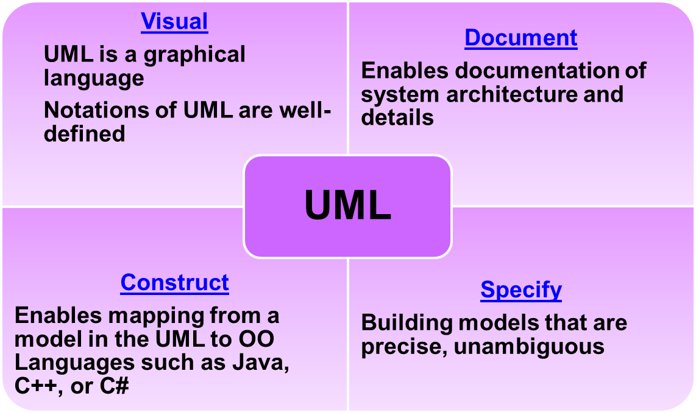
The Unified Modelling Language (UML)
“The Unified Modelling Language (UML) is a language for specifying, constructing, visualizing, and documenting the software system and its components”[OMG03a]
Notes:
Booch and Rum Baugh worked towards the Unified Modeling Language (UML) in 1994
UML only offers a model notation, not a methodology for how to do modeling.
“UML is used by the development method Objectory (Jacobson at Rational)” was the definition given by Jacobson.
UML was proposed by Rational Inc. and by Hewlett-Packard as a standard for object-oriented analysis and design and was adopted by the OMG(Object Management Group)
OMG™ is an international, open membership, not-for-profit computer industry consortium. OMG’s modeling standards enable powerful visual design, execution and maintenance of software and other processes.
Vendors modify their CASE tools to make them consistent with UML.

Slide 39
UML Diagrams
UML diagrams are the notations used to represent the model in different stages of the OO development process
In UML, there are nine standard diagrams used in different phases
Use Case Diagram
Class Diagram
Object Diagram
State Diagram
Component Diagram
Deployment Diagram
Collaboration diagram
Sequence Diagram
Activity diagram
Notes:
The details of all of these diagrams are out of scope of this course. The objective is to be aware of the diagrams which constitute the object oriented design.
Use Case Diagram and the Class diagrams will be used in this course .

Slide 40
Use Case Diagram
Use-case: a technique to capture business process from the user’s perspective i.e., a way of documenting system functionality expected by the user
Jacobson: “A use-case is a processing sequence which the system is required to perform to fulfil a functionality desired by a user”
Helps in identifying classes

Slide 41
Use Case Diagrams
Term | Meaning | Notation used | Example
System | Something that performs a function |  | Retail System
Actors | Represent the users of the system |  | Customer
Use Cases | Represent the actions /activities that a user takes on the system ie. functionality
Pay Bill

Slide 42
Use Case Diagrams
Term | Meaning | Notation used | Example
Relationships | Connects the users to the use cases
 | Generalization (included in a hierarchy) Specialization(included in a hierarchy)
 | include
Pays Bill
Customer
Customer
Registered Customer
Regular Customer
Pays Bill
Purchase
Customer

Slide 43
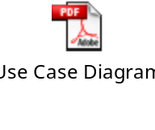
Use Case Diagram- A complete example
Steps to create a Use Case diagram
  Identify the actors in the system
  Identify the use cases
  Identify the relationships
  Create a Use Case diagram

Slide 44
Class Diagram
Collection of classes along with the collaborations and relationships among classes
Class Diagrams has three compartments –
  Classifier Name
  Attributes
  Operations
Notes:
Recollect that OO Analysis concerns with determining the System Requirements and identifying classes and their relationships that make up an application
Class notations can represent at two levels
Analysis Level: Depicts only the attributes and operations
Implementation Level: Depicts attributes, operation and their visibility

Slide 45
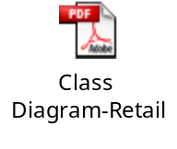
Class Diagram – Components
Customer
-customerNo:int -customerName:String
+getCustomerNo():int +setCustomerNo(int) +getCustomerName():String +setCustomerName(String) +displayBillAmount()
Name of the class
- Represents private access specifier
Attributes of the class
+ Represents public access specifier
Methods or activities in the class
Represents is-a relationship
RegisteredCustomer
-dateOfRegistration:date -discount:float
+getDateOfRegistration():Date + setDateOfRegistration(Date) +getDiscount():float +setDiscount(float)
RegularCustomer
-creditPoint:int
+getCreditPoint():int + setCreditPoint(int)
Notes:
Recollect the concept of Encapsulation and Abstraction learnt earlier as part of the OO concepts. This diagram represents both the features . The Customer class encapsulates/hides the Customer Id and Name(attributes of the class). Hence we say these attributes are private to the class. It exposes the get and set methods which are public . These methods allow limited access to the attributes through them. Registered and Regular customers are a kind of customer, representing inheritance or hierarchy learnt earlier

Slide 46
Class Diagrams
Term | Meaning | Notation used
Class | The name of the class, attributes and methods
Relationships | is-a relationship Generalization Specialization
 | has-a relationship(Aggregation)
 | Uses –a relationship(Association)
Class Name
Attributes
Methods
Notes:
Although the class diagrams do not follow use case diagrams directly in the OO software development process , from a developer perspective, the use case can be used to design classes .

Slide 47
Object Oriented Tools

Slide 48
UML Tools
IBM Rational Rose
  Rational Rose modeling tool is from IBM Rational Software Corporation. Rose stands for "Rational Object-oriented Software Engineering") is a visual modeling tool for UML
Together Control Center:
  Together Control Center (formerly from Togethersoft) from Borland is an entire suite of visual modeling tools for UML
Poseidon:
  Poseidon from Gentleware has its roots in the ArgoUML open source project which evolved as an open source effort and is a useful, full-featured UML tool freely available under the Open Publication License
Notes:
An exhaustive study of the tools is out of scope. This slide tries to create an awareness on the various tools available

Slide 49
Learning approach
The following are strongly suggested for a better learning and understanding of this course:
  Noting down the key concepts in the class, explained by the educator
  Analyze all the examples / code snippets provided
  Study and understand the self study topics
  Completion and submission of all the assignments, on time
  Completion of the self review questions in the lab guide
  Study and understand all the artifacts including the reference materials / e-learning / supplementary materials specified
  Completion of the project (if applicable for this course) on time inclusive of individual and group activities
  Taking part in the self assessment activities
  Participation in the doubt clearing sessions

Slide 50
Summary
Interfaces
Packages
Object Oriented Analysis and Design

Slide 51
Thank You

Slide 52
Appendix

Slide 53
Appendix - UML Diagrams
UML Diagrams | Meaning of the diagrams
Use Case Diagram | Shows use cases, actors, and their interrelationships
Class Diagram | Shows a collection of classes and types, their contents, and their relationships
Object Diagram | Depicts objects and their relationships at a point in time, it is a special case of a class diagram
State Diagram | Describes the states an object and the transitions between states
Component Diagram | Depicts the components that compose an application, their interrelationships, interactions, and their public interfaces are shown in this diagram.
Deployment Diagram | Shows how the application is deployed, the hardware or software execution environments, as well as the middleware connecting them
Collaboration diagram | Shows how the objects send and receive messages, ie. Communication
Sequence Diagram | Shows sequence/time ordering between messages
Activity Diagram | Shows high-level business processes, data flow, and how to model the logic within the system

